Slide 1

FINAL REPORT ON MY PCTO EXPERIENCE

Slide 2
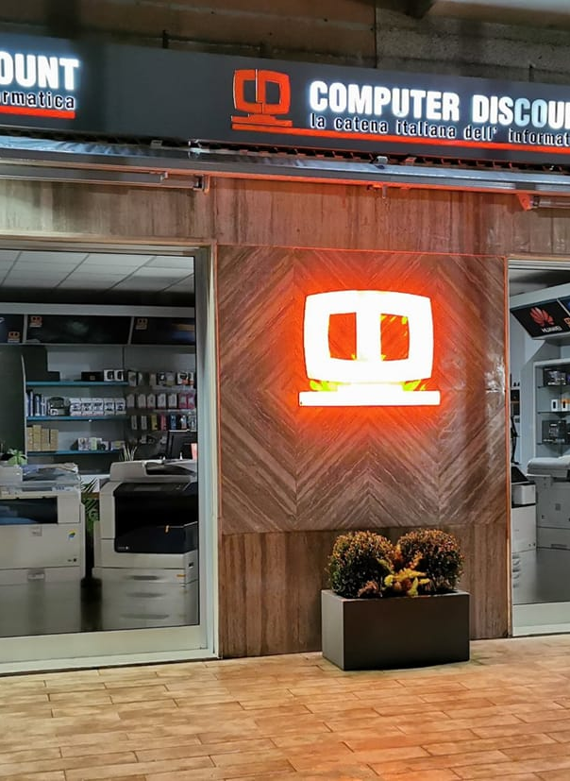

ABOUT THE COMPANY
I was inserted to the company Computer Discount Srl. Is a company that deals with sales and repair/ maintenance of electronic devices. And I was assigned to the repair and initialization department at hardware level.
COMPUTER
DISCOUNT

Slide 3
SALE OF ELECTRONIC DEVICES IN STORE
01
SALE OF ELECTRONIC DEVICES ONLINE
02
SERVICES PROVIDED BY THE COMPANY
REPAIR OF ELECTRONIC DEVICES
03
DATA TRANSFER BETWEEN DEVICES
04
Among the products sold in store we have printer cartridges, desktop and laptop computers, phones/tablets, and other computer equipment such as mice etc..
Online sales means that customers can request to order any component online. You can request this by calling or asking in the shop.
This is the main function of the shop, to repair problems with all kinds of devices and to solve problems encountered by customers.
Customers often request to transfer data or from internal hard drives, now full, in some more spacious. Or to transfer data between smartphones.

Slide 4
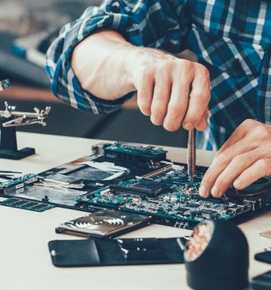
MY DUTIES AS A MEMBER
During this time I was fortunate enough to perform several tasks to improve my work skills:
The main one was customer troubleshooting from electronic devices. I often had to disassemble laptops or PCs to replace damaged parts, such as hard drives or fans, or for dust cleaning.
Other times I found myself assembling from scratch fixed PCs, and then even initialize them by inserting the Operating System (Windows) and installing starting applications.
A final task was to rewrite and print the price list with price tags of various items in the store such as printer cartridges, bluetooth headphones etc..

Slide 5
MY AUTONOMY IN CARRYING OUT TASKS
MY ABILITY TO WORK IN TEAM
WHAT I LEARNT ABOUT. . .
MYSELF
I often found myself at the beginning of the path having to explain how to perform various actions, taught me how to work within the hardware part of the computer, or the right programs to install. For the rest I managed to solve many of the problems independently.
I have often worked together, except to learn how to perform certain tasks. Sometimes, however, my two colleagues and I have had to work together to solve or figure out how to solve more complex problems. In this respect I noticed that I found working in a group very good, especially on the side where I was told what to do and how to do it, giving me a lot of confidence.
Of myself I noticed that often, due to my timidity, I could not ask for help from my more experienced colleagues. At the same time I have noticed a personal growth, preparing myself more and more for the world of work.

Slide 6
DIFFICULTY AND PARTICIPATION LEVEL
First of all, the skills required in this type of work are certainly basic electronic skills. Then also other skills from the sales side, such as knowing how to choose the best item to buy, balancing expenses etc..
About of the skills required, I was able to see that my work had not been too complex compared with my own abilities. There were also some suggestions from me based on some work requests.
I rate my level of participation as very high, collaborating as much as possible, always trying to learn new things, also asking questions frequently. I was also able to perform several autonomous functions such as (as written above) the assembly of PCs even quite complex.
One particular difficulty was certainly the timidity towards my colleagues. Another difficulty was, as mentioned above, the lack of knowledge of many terms in the electronic field. And also the not know how to perform, at the beginning of experience, many of the requests. But in time I was lucky enough to learn quite well.

Slide 7
MY EXPECTATIONS
Honestly my expectations before the start of PCTO were negative, I expected it would be a boring and useless experience. Instead I was more than surprised by what turned out to be this experience. It will certainly have repercussions on my future, being also passionate about the work in which I was inserted. Making it also a possible starting point for future work.

Slide 8
TUTOR AND ASSISTANCE
RELATIONSHIP WITH MY TUTOR
My tutor has shown some distant relationships. The tutor showed up to work once during the first period for a general check-up, otherwise, as there were no problems, I had no reason and no way to talk with my tutor..

Slide 9



IMPROVEMENT SUGGESTED
ORGANIZATION
TUTOR SUPPORT
There were two points that can be talked about and the aspects to improve
Certainly one aspect that can be improved is the general organization. Such as the fact that I was initially assigned to another company, being redirected into this almost last, or even the organization during the transition between the end of the experience and the beginning of the year, not making the practices to be done with various PCTO documents so specific
I did not have a good relationship with my tutor, almost absent and unable to provide me with help and a clear answer when I needed to know what to do about the disappearance of some documents.

Slide 10

Thank you very much for reading and taking the time. This was my final report about the PCTO experience

